Slide 1

DDBM
A CANVAS-BASED METHOD
to create business value with data and AI

Slide 2
Project Id card
Date : _________________________________
Company Name: __________________________________
Number or name of your group: __________________________________
Team members:
__________________________________________________
__________________________________________________
__________________________________________________
__________________________________________________
__________________________________________________
__________________________________________________

Slide 3
What business function does your team represent?
Nom de groupe: _______________________________
Design office / innovation
Marketing
Facility management
Production
Sales
Digital services
Finance
HR
IT department
Board of directors
Legal
Customer management

Slide 4
The value of the DDBM method
Group name: _______________________________
Today, the strategic challenges of companies are very often linked to digital transformation. Examples:
Overcome high logistics costs by better tracing/organizing supplies
Produce better quality, at lower cost, and with less waste
Develop innovative, practical, "smart" and useful products thanks to data analysis and AI
Changing your business model: from a sales model to a platform subscription model
Improve compliance and communication with better traceability/governance of information and product flows
Renew interfaces and distribution channels so that your products and services are accessible to your users as easily and widely as possible, on all channels
Better control of budgets and of the efficiency of your support activities (marketing, finance, HR, etc.) thanks to automation better reporting
Improve your customer prospecting and conversions to grow your business
The DDBM method deployed in the following slides is an action guide to identify these challenges and respond to them by putting data and AI into action.

Slide 5

First, key step
Group name: _______________________________
We'll start by naming the company's strategic goals.
A company typically has many hot issues.
But doing strategy is... knowing how to choose the key priority. In the next slide, identify the critical issue for the company over the next 3 to 5 years.
If you were to read only one strategy book

Slide 6

Canvas #01 Strategic objectives
Designed by: ________________________________________
Date: __________________________________________
“In 5 years time, we must be the leader of ………………..………………….
“By providing …………………………….…..…. to ………………..………...
Which translates into these 3 strategic objectives:
#1 …………………………….…..……………………………….…..…
#2 …………………………….…..……………………………….…..…
#3 …………………………….…..……………………………….…..…
What is a "Strategic objective"?
It is a weakness or threat that jeopardizes the viability of the company in the medium term. The objective is to fix it.
Or it is an advantage to be acquired, or an opportunity to be seized, that would allow the company to ensure its development. The objective is to turn this potentiality into reality.
Or, in your own words:
…………………………….…..……………………………….…..…
…………………………….…..……………………………….…..…
…………………………….…..……………………………….…..…
Copyright © 2017-2023, Guillaume Lecuyer et Clement Levallois. DDBM is for you to use without restriction in modeling your own or other people's businesses. License CC BY-SA 4.0 Deed

Slide 7
A project… for whom?
We can now reflect on how best to address this strategic challenge.
A strategic challenge is often so "gigantic" that it cannot be solved with "one project". The response must be broken down into sub-projects. This set of sub-projects will contribute to achieving and meeting the challenge.
How do you define and identify one of these sub-projects? We propose the following method:
Let's identify the stakeholders impacted by this strategic challenge, and the project will then be the solution that addresses their needs.
Examples:
If our strategic challenge is to reduce logistics costs, then the stakeholder could be the team managing the logistics.
If our strategic challenge is to achieve a better quality of service, then the stakeholder can be a customer segment, or account managers, or distributors
Copyright © 2017-2023, Guillaume Lecuyer et Clement Levallois. DDBM is for you to use without restriction in modeling your own or other people's businesses. License CC BY-SA 4.0 Deed

Slide 8




Canvas #02
Identifying the target (pick just one)
Designed by: ________________________________________
Date: __________________________________________
Name of the target department / user / segment:
_________________________________________________
Headquarters / Corporate / Support functions
Name of the target department / user / segment:
_________________________________________________
Production
Name of the target department / user / segment:
Customers / users
Name of the target department / user / segment:
_________________________________________________
New markets
Copyright © 2017-2023, Guillaume Lecuyer et Clement Levallois. DDBM is for you to use without restriction in modeling your own or other people's businesses. License CC BY-SA 4.0 Deed

Slide 9
Canvas #03.1 (B2C version):
Profiling the target user with an avatar
Designed by: ________________________________________
Date: __________________________________________
Name of the Avatar: _____________________________________
Socio-demographic attributes
Lifestyle
Age: ___
Marital status: ________________
Number of kids: ___
Occupation: ________________
Monthly income: ________________
Country & city of residence: _______________
Highest degree: high school / univ / other: __________________
Level of fitness: weak / average / fit / competitive
Social life: none / occasional / regular / party animal
Societal involvement: none / occasional / regular / leader
Media and cultural preferences
The last book they read: ______________
Their preferred TV show: _____________
The last movie they went to: ____________
Preferred extra professional activity: __________________________________________
The social media they visit daily: Facebook / Instagram / Snapchat / LinkedIn / Twitter / Youtube
Copyright © 2017-2023, Guillaume Lecuyer et Clement Levallois. DDBM is for you to use without restriction in modeling your own or other people's businesses. License CC BY-SA 4.0 Deed

Slide 10
Canvas #03.2 (B2B version)
Profiling the target user with an avatar
Designed by: ________________________________________
Date: __________________________________________
Name of the avatar:_______________________________________
Socio-demographic attributes
Professional Identity
Age : ___
Sex: ____________________
Job: _______________
Country & city of residence: _______________
Highest degree: high school / univ / other: __________________
Nb of spoken languages:: ______
Digital skills: weak / average / high
Industry : _____________
Job Title: ___________
Tenure:: _____________
Title Level : Contributor / Manager / VP / CxO
Professional environment
Which social media are relevant to his/her professional environment:
Facebook / Instagram / Snapchat / LinkedIn / Twitter / Youtube / other / none
Has access to : a computer / smartphone / tablet / other
Participates in investment decisions : Yes / No
Can incur operational expenses : Yes / No
Copyright © 2017-2023, Guillaume Lecuyer et Clement Levallois. DDBM is for you to use without restriction in modeling your own or other people's businesses. License CC BY-SA 4.0 Deed
Notes:
Ce canevas nous permet de décrire l’individu qui corresponde à un segment cible. Un segment cible représente, parmi la population totale de vos utilisateurs finaux, une sous-catégorie relativement homogène et à laquelle vous pouvez adresser une offre spécifique.
Pour Gym Sports, le brief initial nous suggère que notre clientèle à revenus moyens ou élevés est un segment cible prioritaire. Cet avatar décrit donc un individu typique de nos salles de sports correspondant à ce segment:
il s’agit d’une femme car c’est le genre le plus représenté dans nos salles, et dans le fitness en général.
cette femme appartient à une catégorie socio-professionnelle supérieure.
Sources:
http://www.territoires-marketing.fr/infographie-le-marche-du-fitness/
https://www.xerfi.com/presentationetude/Les-salles-de-sport-et-de-remise-en-forme-a-l-horizon-2020_8SME63

Slide 11

Canvas #04
User needs analysis
Designed by: ________________________________________
Date: __________________________________________
What resources do they need to perform their task?
What do they try to deliver?
What frustrations do they experience?
The opportunities and limitations that the users face to achieve their goals
What the user is trying to accomplish
What constraints do they face? (time? budget? distance? legal? etc.)
What KPIs to measure success?
Copyright © 2017-2023, Guillaume Lecuyer et Clement Levallois. DDBM is for you to use without restriction in modeling your own or other people's businesses. License CC BY-SA 4.0 Deed
Notes:
Ce canevas poursuit la caractérisation fine des utilisateurs auxquels notre projet va s’adresser. Nous avons un avatar (voir canevas précédent): mais quelles sont ses besoins, frustrations, aspirations, attentes?
La description détaillée de ces “problèmes à résoudre” va orienter notre réflexion sur le type de solutions que nous proposerons.

Slide 12
Canvas #05
Data Sources
Designed by: ________________________________________
Date: __________________________________________
via objects
about people
Note: you can identify existing data sources or imagine data sources that should be created or collected
from the past
(archives, databases)
on websites / Internet / mobile apps
related to an event
third party data / open data
Copyright © 2017-2023, Guillaume Lecuyer et Clement Levallois. DDBM is for you to use without restriction in modeling your own or other people's businesses. License CC BY-SA 4.0 Deed

Slide 13
Canvas #06
Details of datasets
Designed by: ________________________________________
Date: __________________________________________
BONUS POINTS 1 to 5 (1 = hard, 5 = easy) | Explanations | Dataset 1: ________ | Dataset 2: ________ | Dataset 3: ________
Machine readable? | if the data is in a .docx or pdf file, software can’t read it. A database or even a csv file is better.
Structured or not? | if the dataset is “Excel like’ then it is quite structured. Free text, web pages or pictures are typically very unstructured.
Personal and sensitive data? | Personal data comes with more constraints. Sensitive data even more.
Complete? | No missing records, years, values, and no errors.
Sum of points per dataset | Add up the points to get a total. A higher total would suggest that the dataset will be easier to manage
Copyright © 2017-2023, Guillaume Lecuyer et Clement Levallois. DDBM is for you to use without restriction in modeling your own or other people's businesses. License CC BY-SA 4.0 Deed

Slide 14
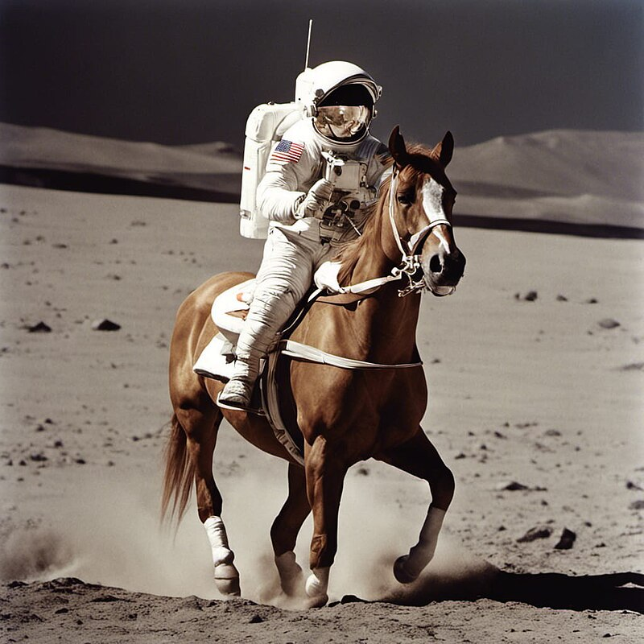


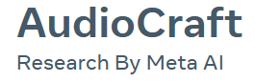






Canevas #07
Amplifiers: interface and delivery
- transform existing pictures
- generate pictures / logos / schemas
- assistance to graphic design
- generation of avatars (animated or not)
- generation of full bodied avatars for existing persons, with voice and lip synch
generation of short movie clips
DALL·E 2
Image Generators
Would an image generator have any relevance to a solution serving your user?
❑
- “text to speech”
- cloning of the voice of an existing person
- music generation according to a preset style etc.
- synch between images and sound
Sound Generators
Would a music, voice or sound generator bring more value to your service?
❑
Text Generators
Can your data be used for a "fine tuner" GPT or a similar model?
- chatbot interface
- augmented search engine (‘RAG’)
- text generation (translations, documentation, original texts, etc.)
- quality amplifier: takes a text input and make it “better”
❑
The "chainers"
Could an automation tool create a service by chaining several 'links' or 'sub-elements'?
❑
Using Zappier, Make or LangChain, or by writing code that will connect the APIs of gen AI services to another
🦜️🔗 LangChain
Copyright © 2017-2023, Guillaume Lecuyer et Clement Levallois. DDBM is for you to use without restriction in modeling your own or other people's businesses. License CC BY-SA 4.0 Deed
Notes:
Ce canevas est l’occasion de faire la liste de toutes les données qui peuvent se prêter à construire une solution venant répondre aux besoins de l’avatar.
Une recherche documentaire - ou sur le terrain! - vous permettra de ne pas négliger des sources importantes de données.
Ici, nous ne prétendons pas que Gym Sports dispose de toutes ces sources de données. Nous imagions les sources de données désirables pour le design d’une solution aux besoins du segment cible.

Slide 15


Canvas #07
Aid to brainstorming
Designed by: ________________________________________
Date: __________________________________________
1
(Re)consider your datasets
- Pick the 3 datasets you identified in the previous canvas
- or consider new ones if necessary
- add amplifiers if suitable (see previous slide)
Each cycle lasts 2 minutes max. Turn until you you hit “stop” in step 3.
3
2
Challenge your results and iterate
How do these datasets contribute to creating a service meeting a need?
Play the devil’s advocate and be critical about your solution:
- Is it strongly aligned with the strategic objectives of your org?
- Is the user really served by the features you designed?
- stop if the solution stands the challenge!
Think of the 7 roads to value creation!
predict / suggest / curate / enrich / rank / compare / match / segment / classify / generate / synthetize
Copyright © 2017-2023, Guillaume Lecuyer et Clement Levallois. DDBM is for you to use without restriction in modeling your own or other people's businesses. License CC BY-SA 4.0 Deed

Slide 16
Canevas #08.2 - Using a GPT to design a solution
[Recommended] follow this guide on how to prompt - the essentials”
Open ChatGPT by OpenAI (3.5 ou 4) or Bard by Google
Copy & Paste the specialized prompt available here in the chatbot prompt window. This launches the "Professor Synapse", an effective prompt tool to facilitate the discovery of solutions.
Copy/paste the content from outlines #1 to #7 to describe to the "Synapse Professor" the elements you have.
an example is available as part of the solved case "Gym Sports" (plain text version, version taken directly from ChatGPT).
Talk to the "Synapse Professor", offering food for thought to move towards a solution, but also asking him to make suggestions.
Copyright © 2017-2023, Guillaume Lecuyer et Clement Levallois. DDBM is for you to use without restriction in modeling your own or other people's businesses. License CC BY-SA 4.0 Deed
Notes:
Nous sommes prêts à élaborer une solution de création de valeur par la donnée qui:
contribue aux objectifs stratégiques spécifiés dès le premier canevas
présente une solution / apporte de la valeur aux utilisateurs cibles, également décrits dans les canevas précédents.
qui valorise les sources de données existantes / aisément accessibles identifiées précédemment

Slide 17
Canevas #08
Value map
Créé par : _________________________________
Date : _________________________________
It helps the user’s acquisition of resources by:
It helps the user deliver x or y because…
The solution is…
It removes or decreases these constraints for the user:
The solution helps the user perform better on these KPIs:
Copyright © 2017-2023, Guillaume Lecuyer et Clement Levallois. DDBM is for you to use without restriction in modeling your own or other people's businesses. License CC BY-SA 4.0 Deed
Notes:
La solution élaborée au canevas précédent demande à être finement spécifiée. Ce canevas vous aide à identifier les multiples voies par lesquelles votre solution vient apporter apporter de la valeur à l’utilisateur final.
Case du centre : définissez les caractéristiques de votre solution: est-ce une app, un objet, un process, ...
Case en haut à gauche : expliquez en quoi la solution vient aider l’utilisatrice à accomplir / réaliser le service
Case en bas à gauche : les contraintes identifiées dans le canevas #4 doivent trouver ici une forme de solution
Case en haut à droite : en quoi les aspirations de l’utilisatrice sont elles rendues réalisables par votre solution?
Case en bas à droite : définissez des indicateurs objectifs sur lesquels votre utilisateur pourra mesurer ses progrès

Slide 18
Canvas #09-1
Graphical synthesis
Designed by: ________________________________________
Date: __________________________________________
contributes to
Strategic Objective 1:
___________
contributes to
Strategic Objective 2:
___________
contributes to
Strategic Objective 3:
___________
4
3
2
Network effects / learning effects
1
ROI
For each dimension, rate the strength of your project from 1 to 4
Time to market
Differentiating
Organisation readiness
Copyright © 2017-2023, Guillaume Lecuyer et Clement Levallois. DDBM is for you to use without restriction in modeling your own or other people's businesses. License CC BY-SA 4.0 Deed

Slide 19
Canvas #09-2
Qualitative synthesis
Designed by: ________________________________________
Date: __________________________________________
Synthesis
Name of the organization | Name of the idea
Target users and their needs / problems to solve
Description of the idea
How does it match the strategic priorities of the org
s
Data sources and type of AI contributing to the idea
Expected benefits
Copyright © 2017-2023, Guillaume Lecuyer et Clement Levallois. DDBM is for you to use without restriction in modeling your own or other people's businesses. License CC BY-SA 4.0 Deed

Slide 20
Canevas #10.3 - qualitative synthesis
Group name: _______________________________
Feasibility
Is the solution clearly defined and achievable?
/ 5
Desirability
/ 5
Is the user properly identified? Its needs are clearly defined? Is the solution a convincing answer to these needs?
Viability
Have the company's strategic objectives been clearly stated? Does the project contribute to achieving them?
/ 5
Communication
/ 5
Did all members of the group participate? Was the presentation (materials and oral performance) professional and of high quality? Has the team won the audience's support?
0: absent
1: insufficient
2: fragile
3: ok / good
4: strong
5: outstanding
total: / 20
Copyright © 2017-2023, Guillaume Lecuyer et Clement Levallois. DDBM is for you to use without restriction in modeling your own or other people's businesses. License CC BY-SA 4.0 Deed

